Slide 1


Building ML Model to Predict Turnover of
the Company
Submitted by:-
Rishabh Gaur
Shivani Chauhan
Vinayak Saini
Submitted to:-
Mr. Sanjay Madan
Centre for development of Advanced computing, Mohali

Slide 2
Presentation Agenda
Introduction
About dataset
Problem statement
Objectives
Methodology used
Implementation
Comparison table
Conclusion
References

Slide 3
Introduction
We were asked to experiment with a real world dataset, and to explore how machine learning algorithms can be used to predict the turnover of a company from the data.
We were expected to gain experience using libraries like Numpy,Pandas,Matplotlib,Seaborn,Scikit-Learn, and were expected to submit a presentation about the dataset and the algorithms used.

Slide 4

About dataset
Description
The data is the price history and trading volumes of the HERO MOTOCORP stock in the index NIFTY 50 from NSE (National Stock Exchange) India.
The dataset is at day-level with pricing and trading values split across the .csv file for the stock. The data spans from 1st January, 2000 to 30th April, 2021.
Source
Original - NSE India: https://www.nseindia.com/
Mirror - Kaggle
Size - 619 kb , Rows - 5306 , Columns - 15
Null Values are present in the Dataset.

Slide 5

Problem statement
The Company wants us to understand the financial aspects and extract useful information, which they can later use to formulate future policies.

Slide 6

Objectives
To extract useful insights from data.
To build a ML model to predict turnover of the company.
Predicting 3 Turnover Cases for the Company namely - Base Case , Worst case , Best Case.
Building a Dashboard for the company to gain Useful Insights.

Slide 7
Technologies Used
Libraries used
Pandas
Numpy
Matplotlib
Seaborn
Statistics
Sklearn
Locale
Models used
Linear regression
Lasso
Elastic Net
Decision Tree Regressor
K Neighbors Regressor
Gradient Boosting Regressor
Tools used
Power-BI
Jupyter Notebook
VS code
Hyper Tuning
Grid Search CV
Kfold

Slide 8
WORKFLOW DIAGRAM
DataSet
Data
PreProcessing
Exploratory
Data Analysis
Data Splitting
(70:30)Ratio
Using Best Model & Hyper-tuning Model
Evaluating All Model And Selecting Best Model
Training
Various ML Model
Making Predictions
Validation of The
Developed Model

Slide 9
Methodology
Step 1 - Dataset is loaded into a dataframe.
Pandas,Numpy used for data cleaning removing & replacing null Values
Step 5 -
Lastly Predicting cases Normalizing Values & Building Power-BI Dashboard
Step 3 - Testing different ML models on Basis of MSE & cross validation Score used for Selection of Best ML Model
Data pre processing
EDA
Model Selection
& Evaluation
Hyper Tuning Model
Prediction of Turnover
Step 2 -
Looking for insights with the help of graph-plotting via Matplot , Seaborn.
Step 4 -
Using GridSearch with kfold & different Parameter to Tune our Model For Minimizing Error & Increasing Accuracy

Slide 10
Comparison table
Model Name | Negative Mean Squared Error
Scaled Linear Regression | -1.436367
Scaled Lasso | -3.341305
Scaled Elastic Net | -2.379917
Scaled Decision Tree Regressor | -0.022647
Scaled Neighbors Regressor | -0.115533
GradientBoosting Regressor | -0.019500

Slide 11
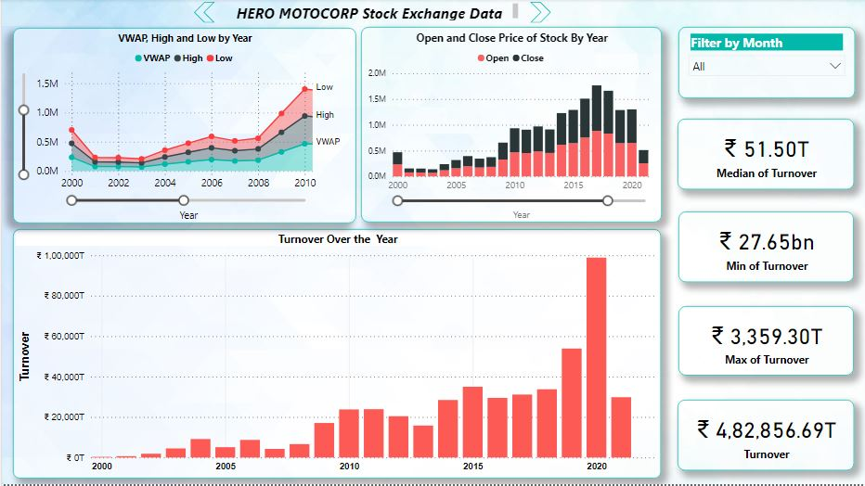
Dashboard 1

Slide 12
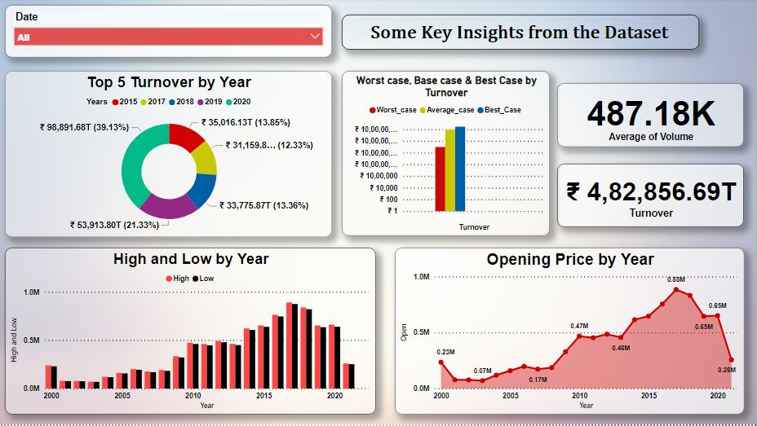
Dashboard 2

Slide 13

Observations
By plotting We found Out Data is Right Skewed and had some null values.
By visual representation we found out maximum turnover was in year 2020.
As we saw in the previous slide, Gradient Boosting Regressor turned out to be the most efficient model for our purpose, hence, it was used to build our model.

Slide 14

Results & Conclusion
Predictions :-
Model R2 Score :-
We found out that out of all ML models, Gradient Boosting turned out best for predicting Turnover when tuned with Gridsearch parameters with an Accuracy Score of 99%.
This ML Project is useful for Predicting Turnover with custom cases for the company.

Slide 15
References
Python Machine Learning case studies.
Five case studies for the data scientist by Danish Haroon.
https://www.kaggle.com/code/junkal/selecting-the-best-regression-model/notebook.
DataSet Source - NSE India: https://www.nseindia.com/.

Slide 16
THANK YOU.

